Slide 1
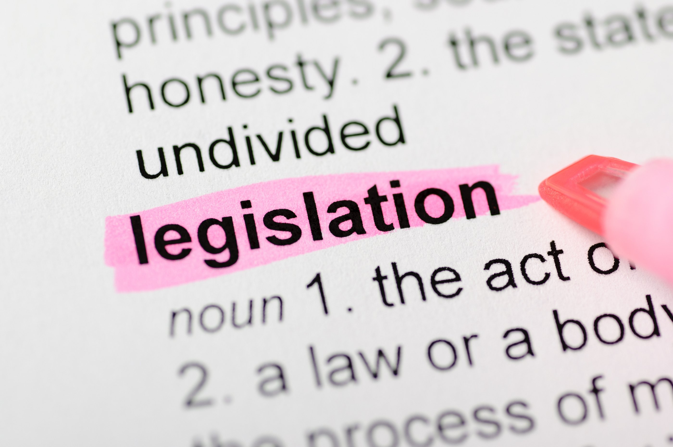
How a Bill Becomes Law in Tennessee: Understanding the Legislative Process and the Importance of Advocacy
Zoë Jamail
1.28.25

Slide 2
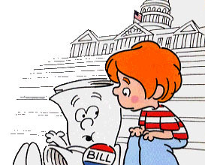
Introduction
Brief Overview of Legislative Process: From “Just a Bill” to Law
Importance of knowing how laws are made and providing effective feedback
Key Objective: Understand how a bill becomes law and the role of advocacy in shaping it into “good” law
Engaging question: “How can we effectively advocate and educate to ensure legislation is viewed through a disability lens prior to becoming law?”
Notes:
https://www.youtube.com/watch?v=SZ8psP4S6BQ

Slide 3
What Makes “Good” Law?
(Psssst it’s you!)
Thomas Aquinas and “Natural Law” Theory
“Good” law is rooted in reason and pursues good
For law to be rooted in reason, principles underlying those laws must be informed by public discourse and other conversation leading to rational reflection
Consideration of stakeholder feedback, input from diverse voices impacted by potential laws, and unintended consequences are essential to making good law
Notes:
https://www.youtube.com/watch?v=SZ8psP4S6BQ

Slide 4
Tennessee’s General Assembly
The Tennessee General Assembly meets for a 90-day regular legislative session held over a two-year period, beginning the second Tuesday in January in an odd-numbered year. 2025 marks the first year of the 114th Tennessee General Assembly, which convened for regular business on Tuesday, January 14, 2025.
Bicameral Legislature:
House of Representatives: 99 members
Senate: 33 members
Role of the General Assembly:
Responsible for creating, amending, and repealing state laws

Slide 5
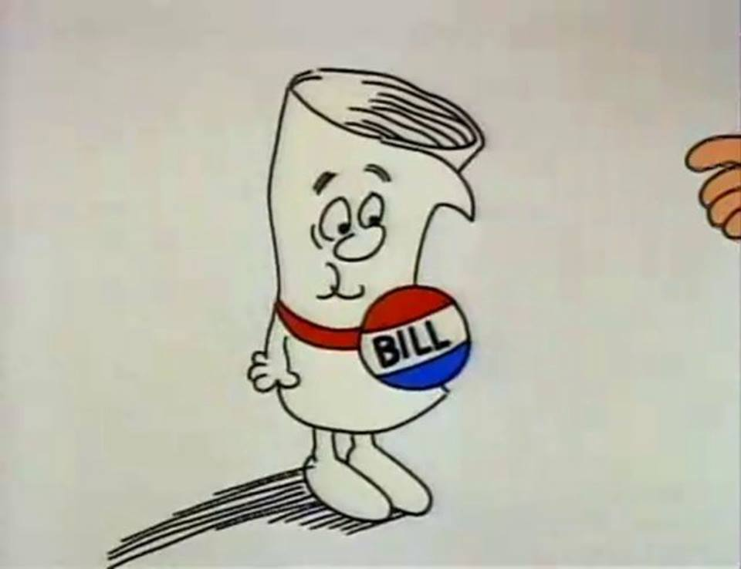
What is a Bill?
Definition of a Bill:
A proposal for new legislation, an amendment to existing law, or repeal of existing law
Appropriations Bills deal with state budget and funding
Be on the lookout for caption bills!!
Importance of Bills: Serve as the foundation for Tennessee’s legal framework
Notes:
https://www.youtube.com/watch?v=SZ8psP4S6BQ

Slide 6
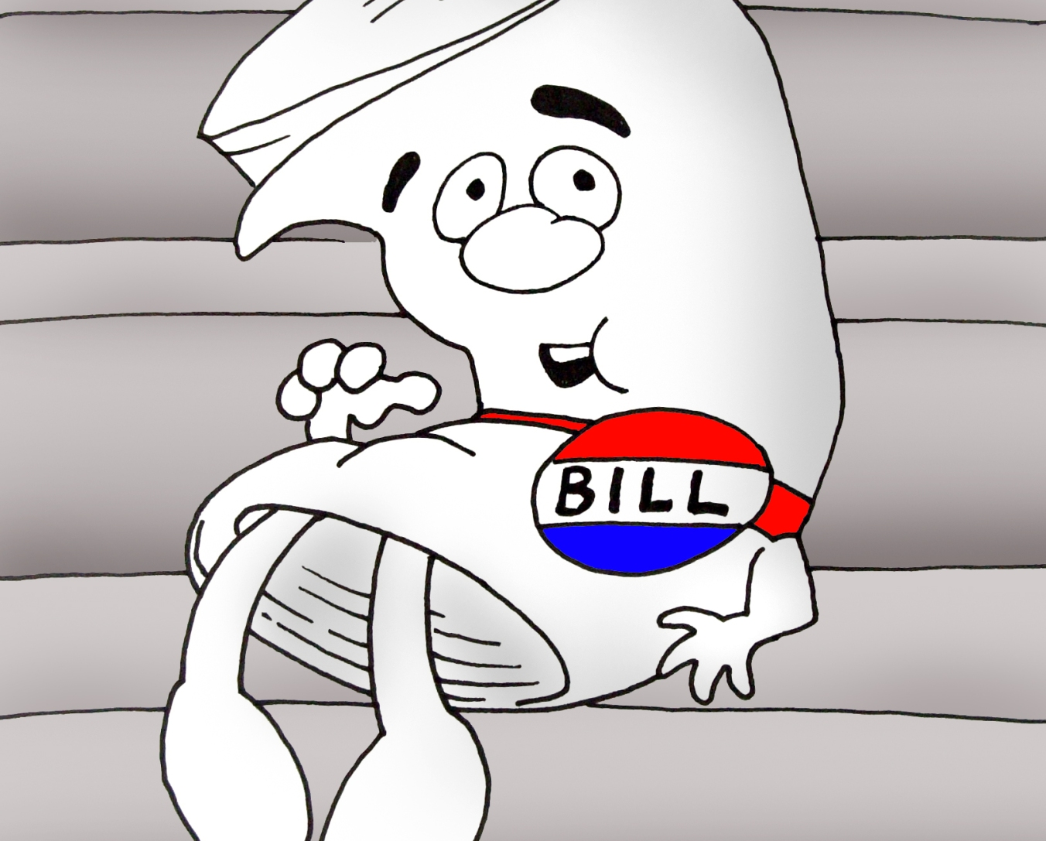
Bill Filing
Who Can File a Bill?
Only members of the General Assembly (Senators and Representatives)
Process of Drafting a Bill:
Collaboration with constituents, legal advisors, and stakeholders
Process for filing the Bill:
Submitted to the Clerk of the House or Senate by the filing deadline
Notes:
https://www.youtube.com/watch?v=SZ8psP4S6BQ

Slide 7
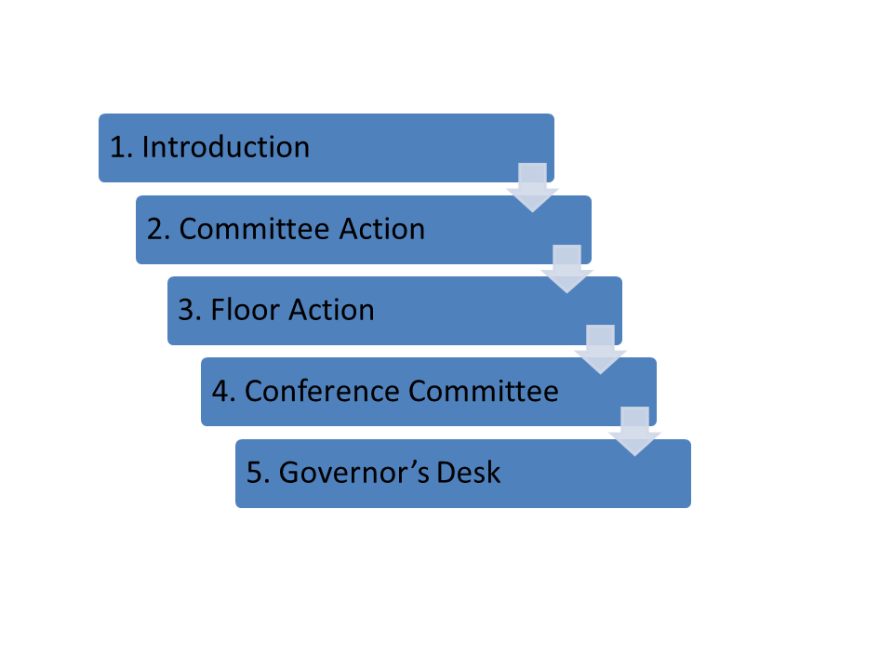
Bill Introduction
Bill is introduced on the House and Senate floors and “passed on first consideration”
Bill is read aloud in the chamber where it was introduced
Purpose:
To officially inform members of the bill’s introduction
Key Point:
No debate occurs at this stage; it is a formality
Notes:
https://www.youtube.com/watch?v=SZ8psP4S6BQ

Slide 8
Committee Review
After introduction on the floor/passage on first consideration, a bill must pass on second consideration (during a subsequent floor session) to be referred to committee
Importance of Committees in the Legislative Process:
Specialized groups that evaluate bills: recommend for passage on third and final consideration or kill the bill
Types of Committees:
Standing Committees (permanent)
Ad Hoc Committees (temporary, “for this”)
Subcommittees (smaller groups focusing on specific issues)
Process of Committee Hearings:
Public hearings for testimonies from advocates and opponents
Opportunity for amendments to be proposed

Slide 9
Third Reading and Floor Vote
Explanation of the Third Reading:
Final reading of the bill before voting
Final Debate:
Members discuss the final version of the bill
Voting Process:
Simple majority needed to pass (50% + 1)

Slide 10
The Other Chamber
Same steps are followed: First Reading, Second Reading, Committee Review, and Third Reading/Final Vote
Key Point: Each chamber must pass the bill in identical form

Slide 11
Resolving Differences in Senate/House Versions of a Bill
Conference Committee Role:
Comprised of members from both chambers to resolve differences in the bill
How Differences Between Chambers are Resolved: Compromise on amendments and provisions
Key Point:
Conference committees take place behind closed doors, with no opportunity for public testimony or debate
Agreed upon version is sent to Governor

Slide 12
Governor’s Approval
Presentation to the Governor:
After passing both chambers, the bill is sent to the Governor
Options for the Governor:
Sign the Bill into Law: Becomes effective law
Veto the Bill: Returns it with objections (General Assembly can override veto)
Allow the Bill to Become Law without Signature: If not signed within 10 days of being transmitted for signature, it becomes law

Slide 13
Overriding Governor’s Veto
Process for Overriding a Governor’s Veto:
Requires a two-thirds majority vote in both chambers
House: 67 votes in favor; Senate: 22 votes in favor
Importance of Veto Power:
Ensures checks and balances in the legislative process

Slide 14
Recap of Legislative Process
Key Steps in the Legislative Process:
Introduction, Review, Voting, Governor’s Approval
Importance of Civic Engagement:
Encouraging participation in local government
Using storytelling to educate about how proposed legislation affects people with disabilities and shape it so disability community does not experience harm/negative impact/unintended consequences
Staying Informed About Legislative Proposals and Using Your Voice

Slide 15
Navigating the Capitol Website and Bill Tracking
https://www.capitol.tn.gov/
https://wapp.capitol.tn.gov/Apps/fml2022/search.aspx - find your legislator
https://www.disabilityrightstn.org/policy-watch/ - Sign up for DRT’s Policy Watch, a weekly newsletter that recaps legislative happenings and highlights bills that impact the disability community
Includes a weekly bill report

Slide 16
Thank you!
Please feel free to reach out:
To chat about a bill
For guidance on issue based education
With any other questions!
zoej@disabilityrightstn.org

